Slide 1
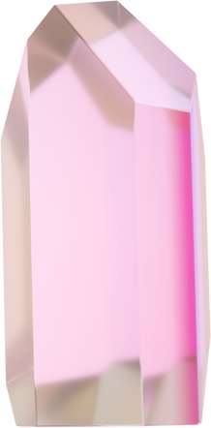




IRONHACK PARIS
DIAMONDS RULE THE WORLD
ARMEN HOUSPESS MONASIANS
1

Slide 2

INTRODUCTION
Diamonds are a precious, costly, and most sought-after commodity in almost every country. While diamonds have been used to grace milestone events like wedding engagements, career ventures and noble coronations. The diamond mining industry is a lucrative sector dominated by a few select companies in the world.
2

Slide 3
GOAL
The goal of my project is to determine what makes a good diamond after analyzing its characteristics, relationships & predictions in order to answer the following questions:
Is the color of a diamond a factor in its clarity?
Is a diamond’s color a factor in determining its cut quality?
What characteristics establish a good diamond?
Which variable(s) is/are the most critical in predicting a diamond’s price?
Is it possible to estimate the price based on the carat?
3

Slide 4

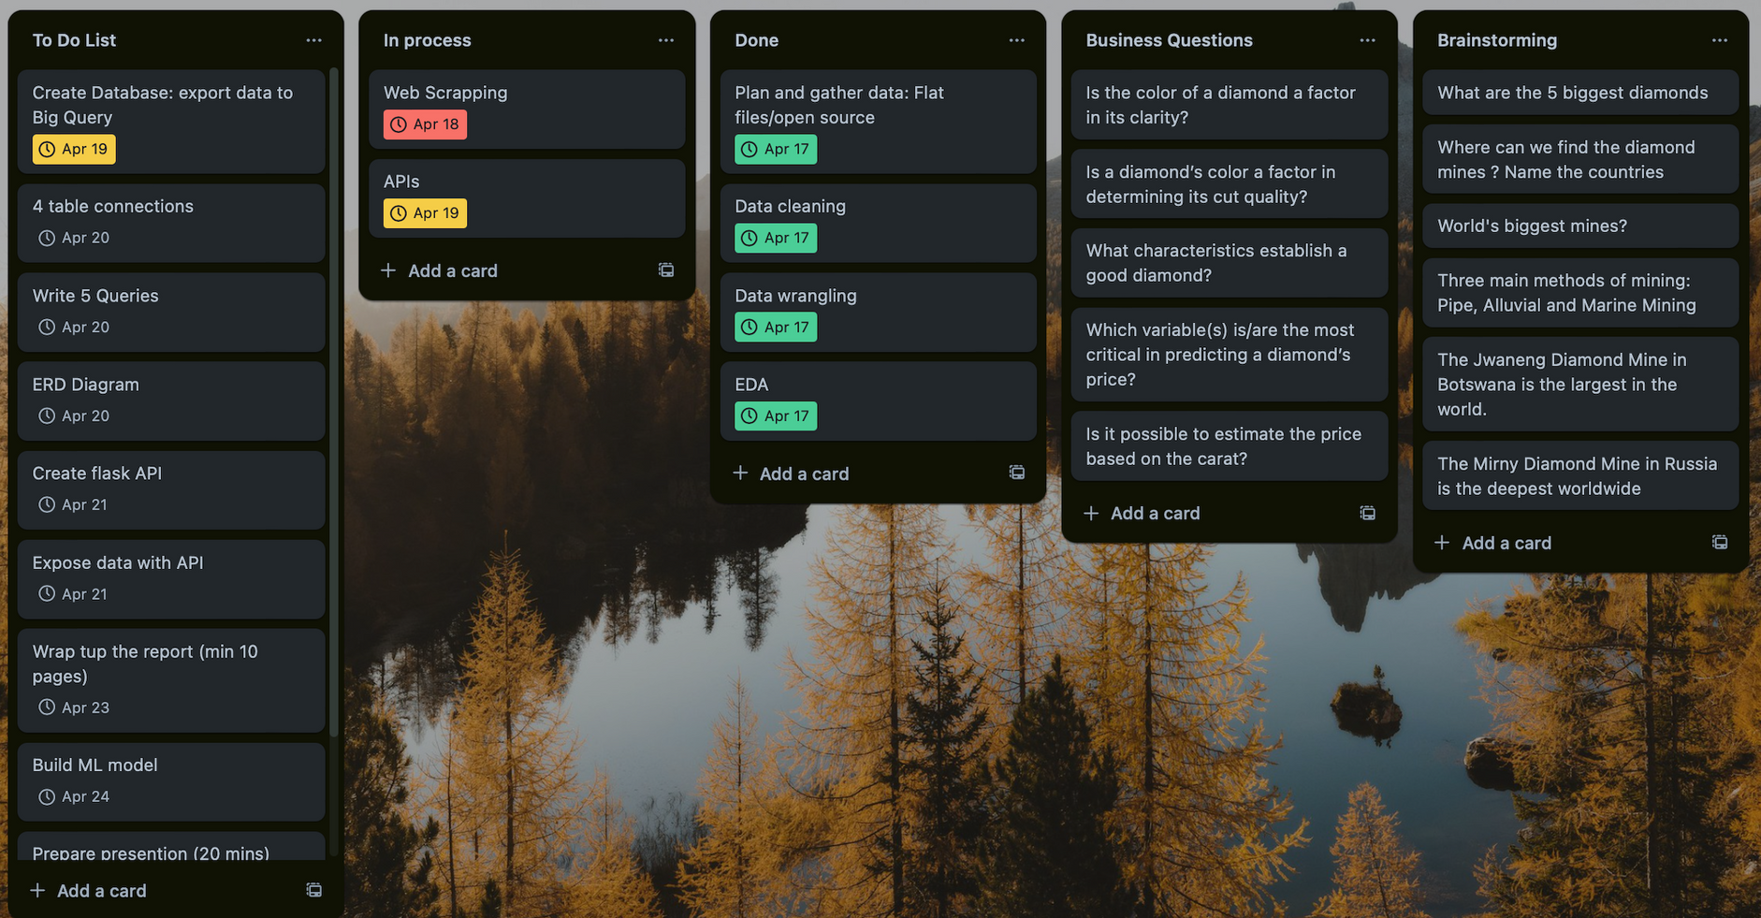

PLANNING
4

Slide 5
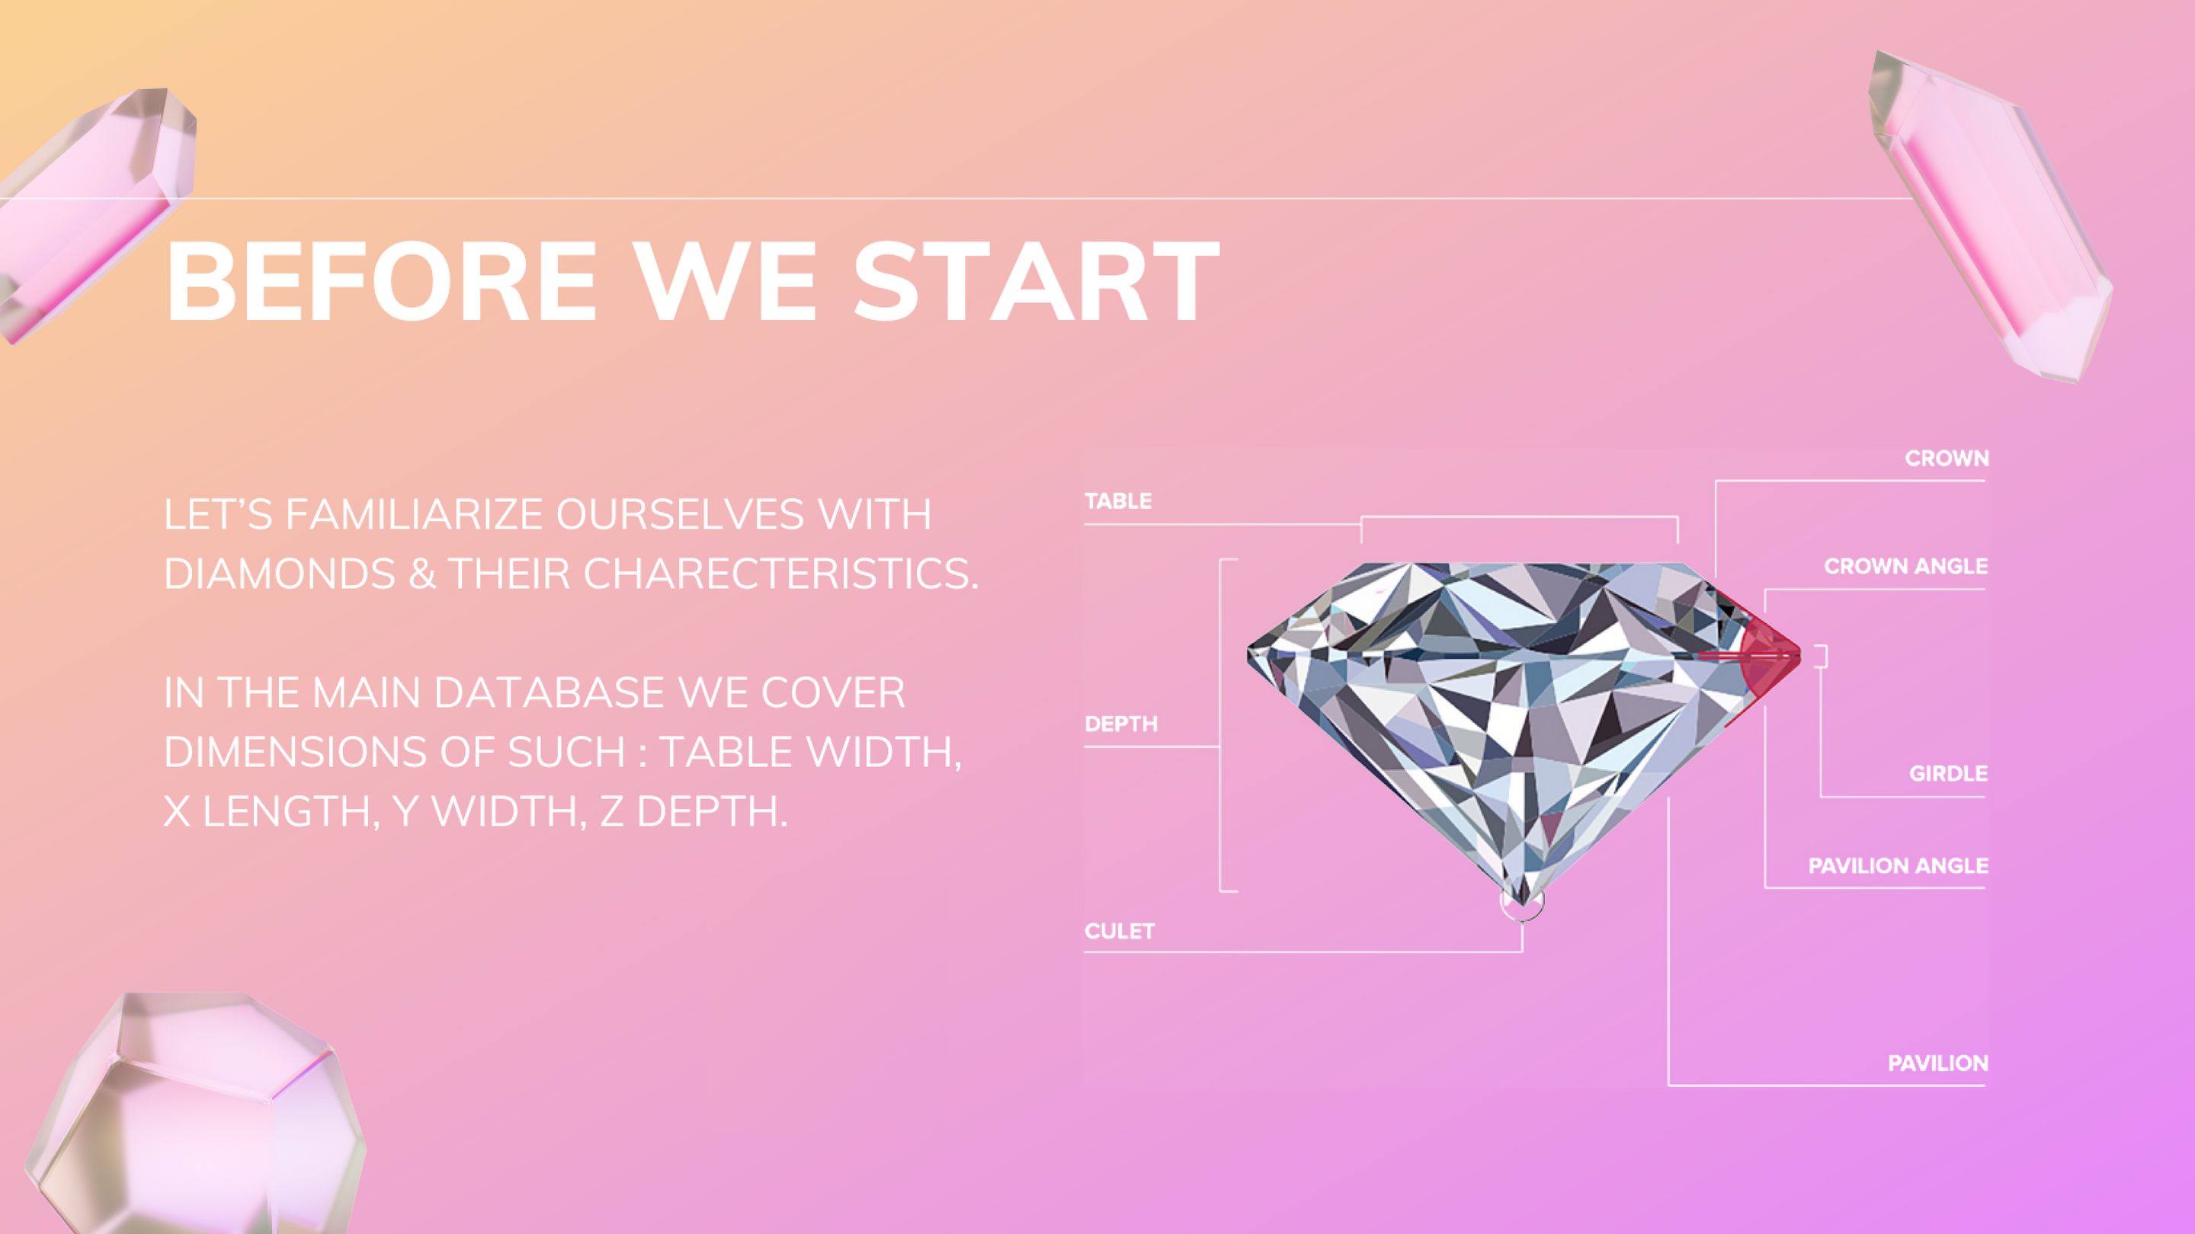
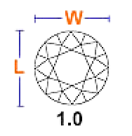
5

Slide 6
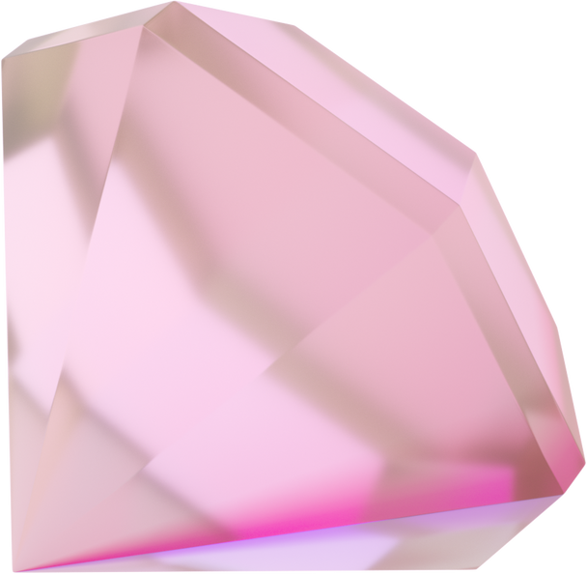
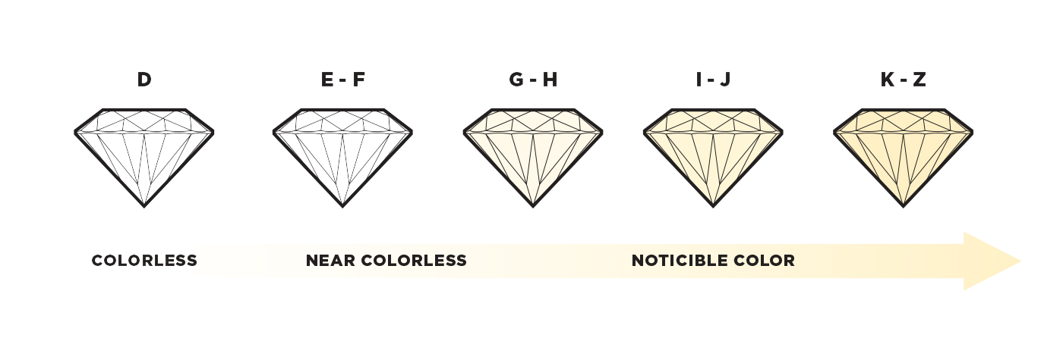
COLOR GRADIENT
6

Slide 7
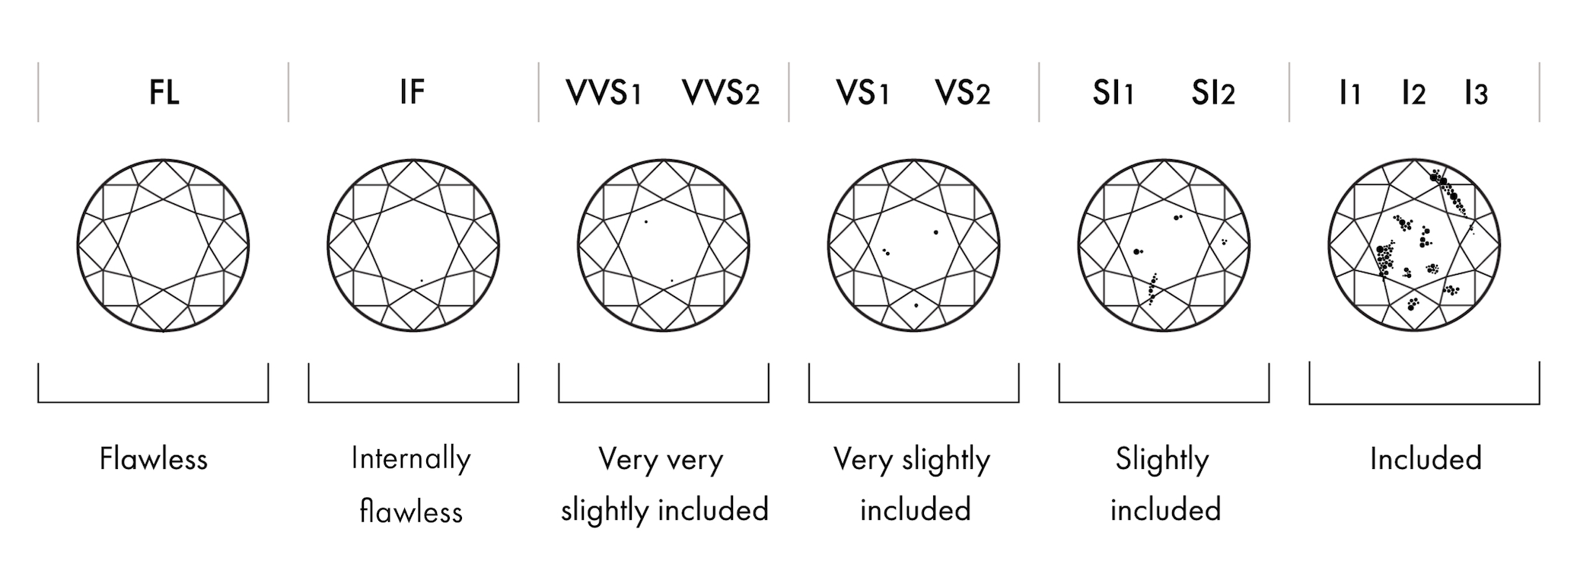
DIAMOND CLARITY SCALE
7

Slide 8

DATA GATHERING
FLAT FILES FROM KAGGLE
GENERATED 4 DATA FRAMES WITH OVER 54,000 DIFFERENT DIAMONDS.
API FROM EBAY DEVELOPPER’S PROGRAM
GENERATED A DATA FRAME OF OVER 5,000 DIAMONDS AVAILABLE ON EBAY MARKETPLACE.
WEB SCRAPPING FROM WIKIPEDIA
GENERATED 2 DATA FRAMES OF THE MOST FAMOUS DIAMONDS & LARGEST ONES FOUND.
8

Slide 9
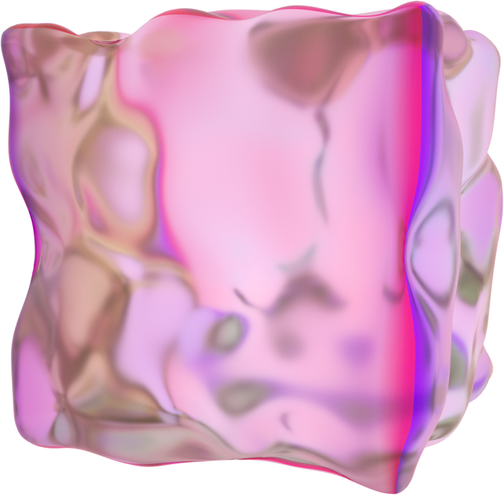
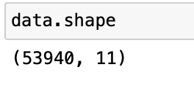
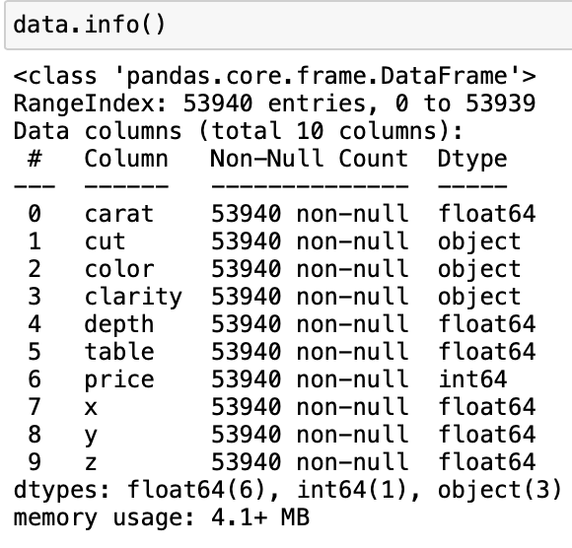
DATA CLEANING/WRANGLING & EDA
01
CHECKING DATA SHAPE
02
CHECKING DATA TYPES & NULL-VALUES
9

Slide 10
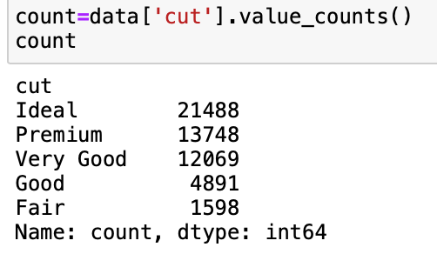
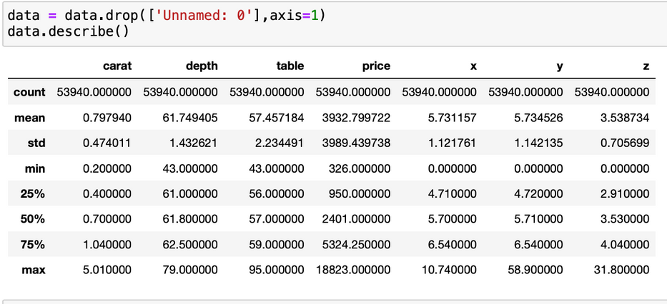
03
CHECKING FOR DUPLICATES
04
VALUE COUNTS
05
DROPPING UNWANTED COLUMNS & UNDERSTANDING THE DISTRIBUTION OF DATA
10

Slide 11
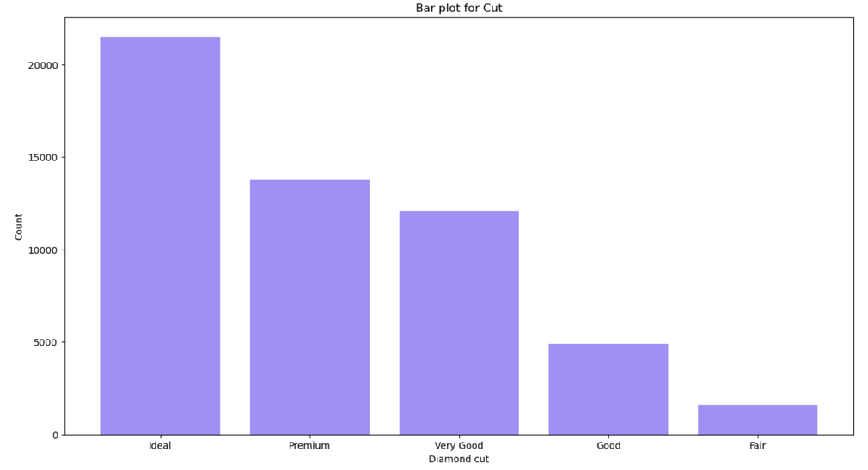
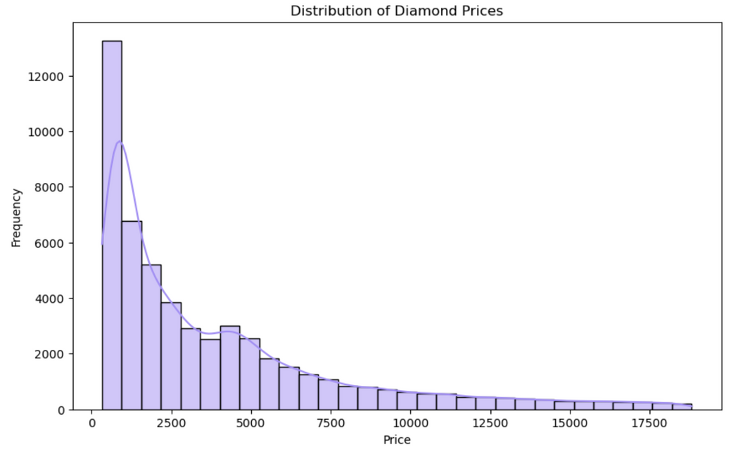
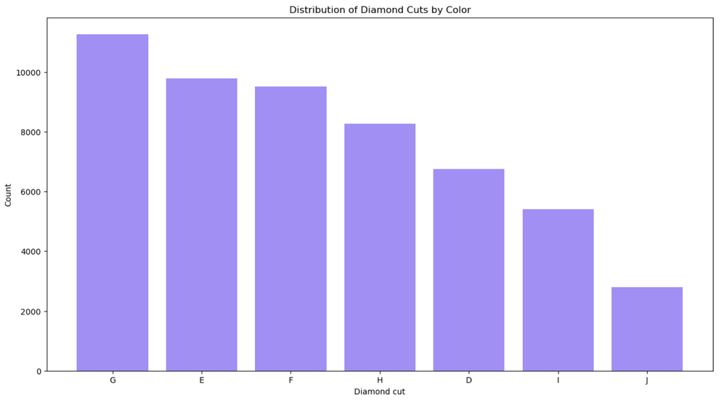
11

Slide 12
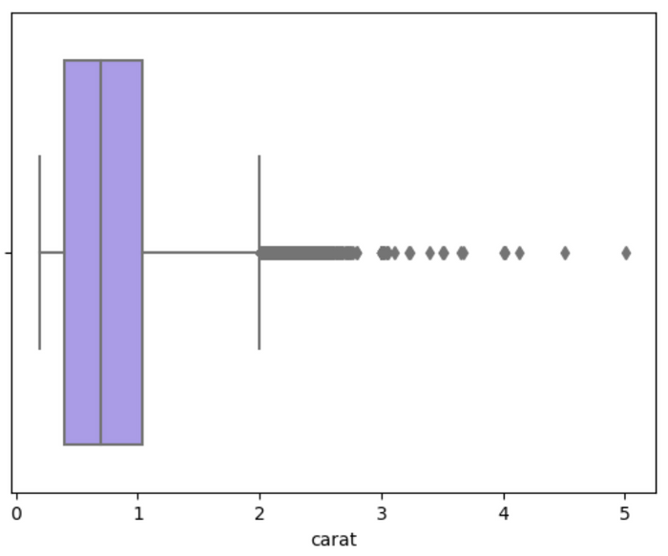
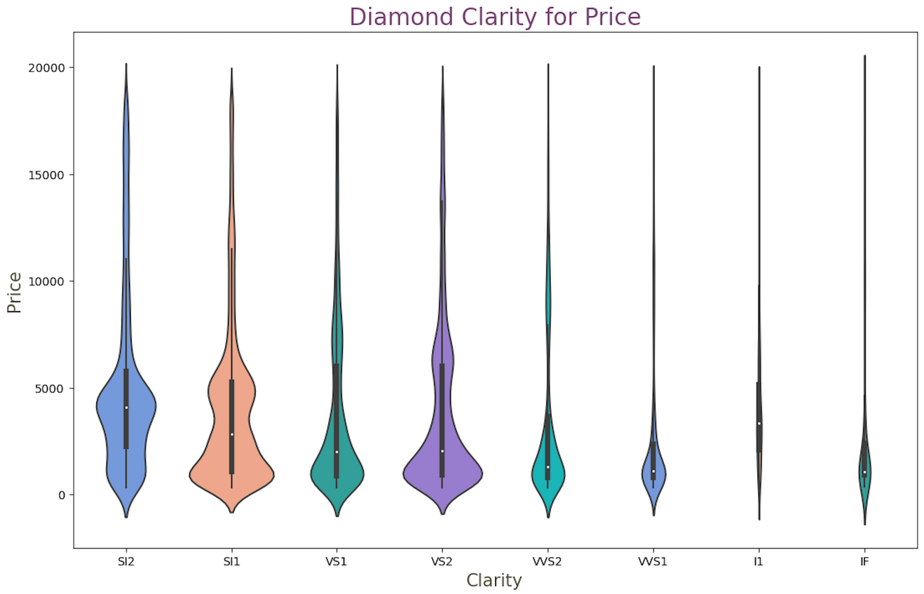
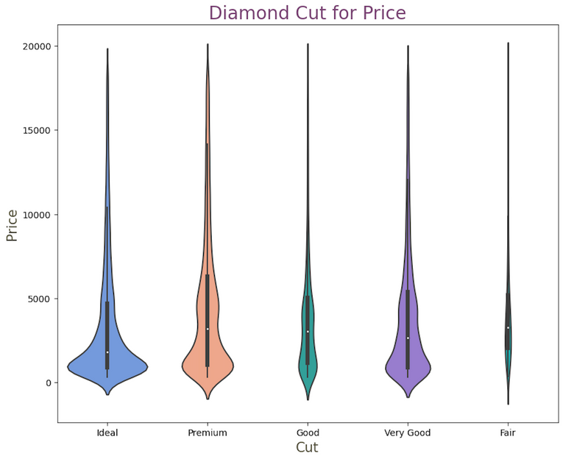
12

Slide 13
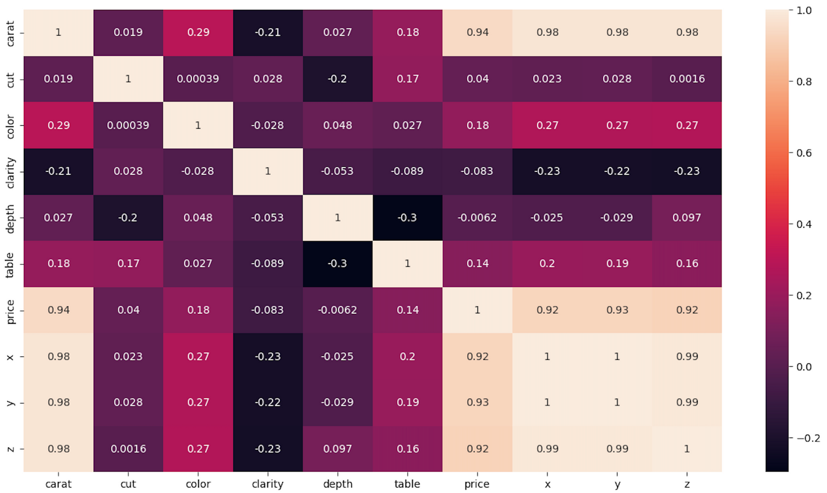
CORRELATION
13

Slide 14
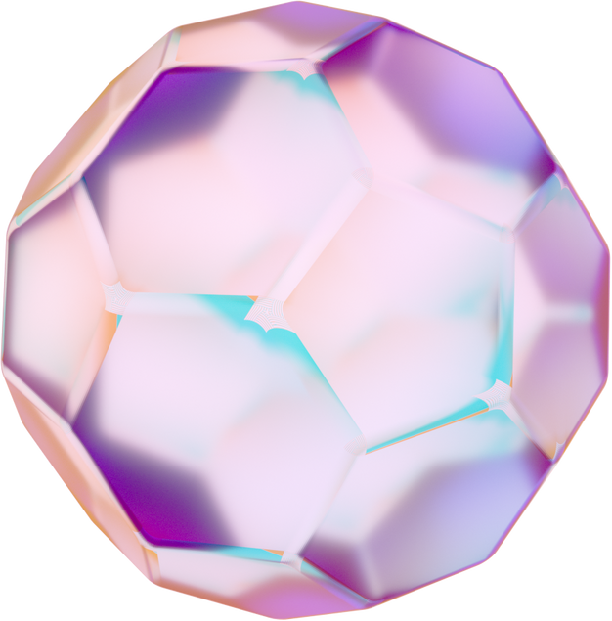
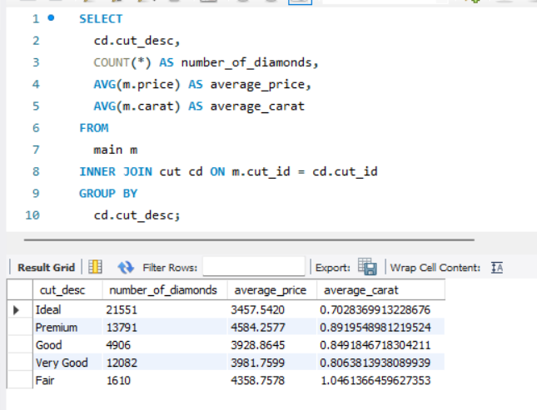
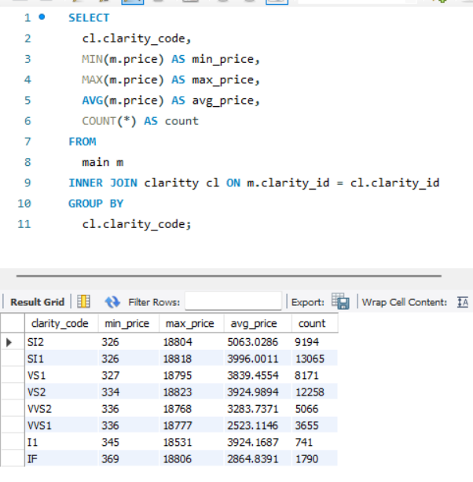
SQL QUERIES
01
AGGREGATED DATA ON CUT QUALITY
This query provides a count of diamonds for each type of cut, along with the average price and average carat weight.
02
STATISTICS FOR EACH CLARITY CATEGORY
Here we get the minimum, maximum, and average price for each clarity category, along with the number of diamonds in each.
14

Slide 15
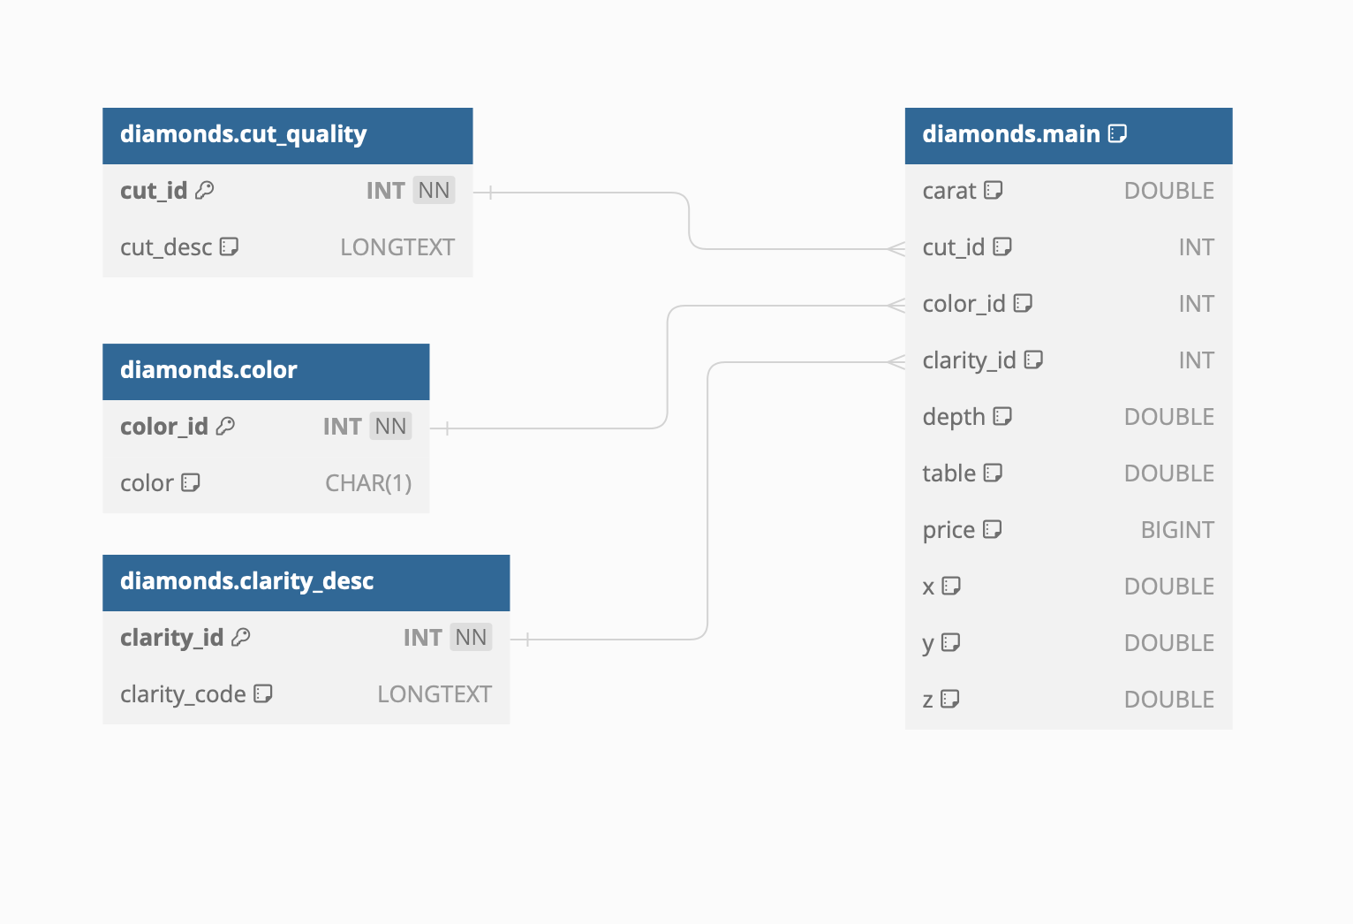
ERD
15

Slide 16
API ENDPOINTS
01
/DIAMONDS/{DIAMOND_ID}
RETURNS X,Y,Z ABOUT SPECIFIC DIAMOND
EXAMPLE URL : /DIAMONDS/3
02
/DIAMONDS
ParameTERS: PAGE, PAGE_SIZE
RETURNS A LIST OF DIAMONDS, MAX PAGE SIZE ACCEPTED = 10
EXAMPLE URL : /DIAMONDS?PAGE=5
16

Slide 17

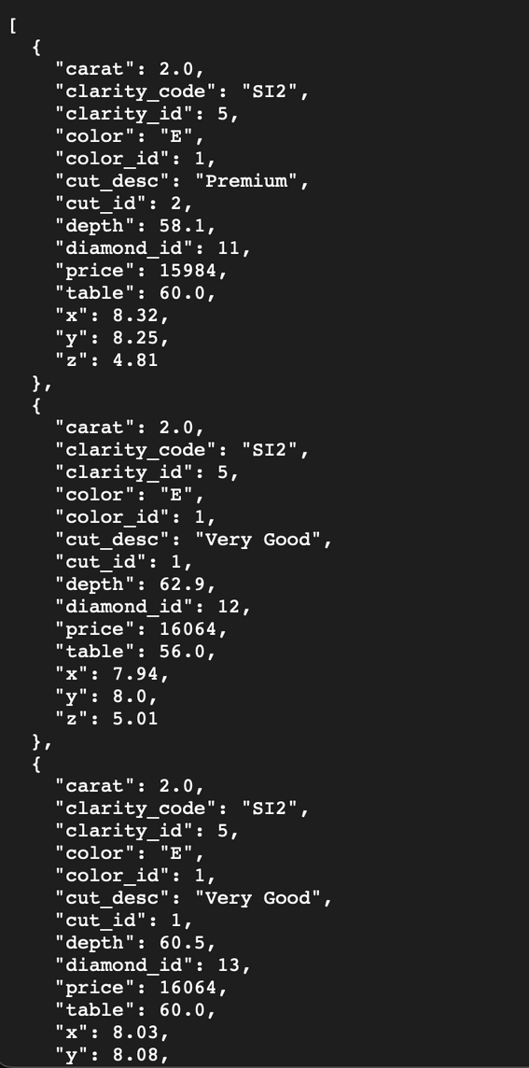
HOW IT LOOKS
LIKE
WHEN LOADED
17

Slide 18
VISUALISATIONS
18

Slide 19
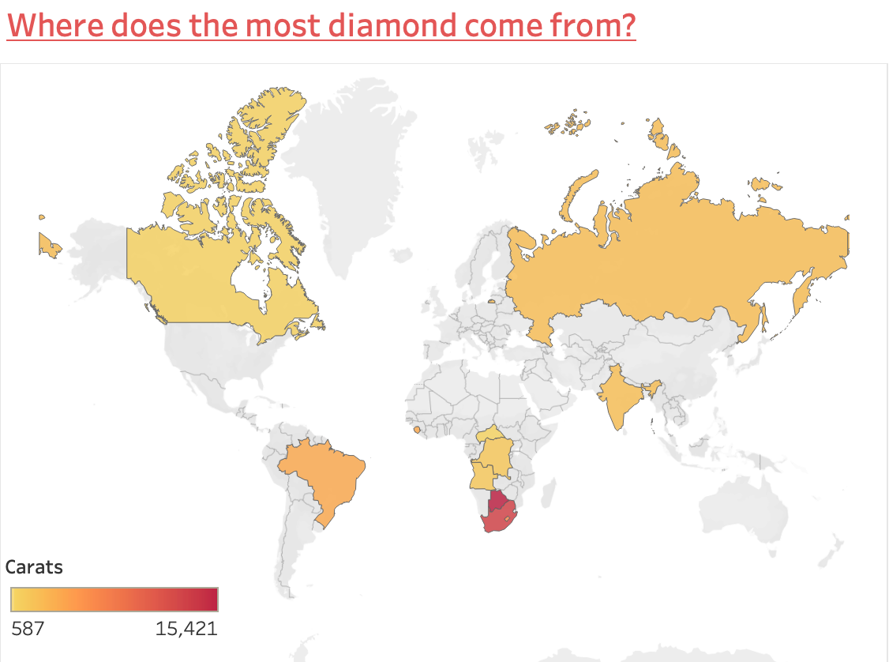
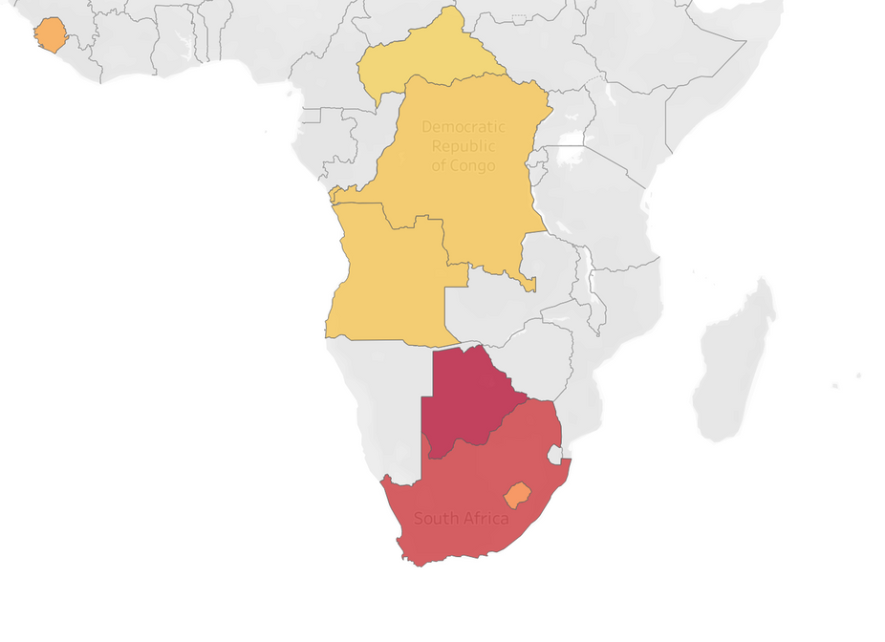
Botswana is where the most diamond comes from (15,421 carats),
followed by South Africa (12,816 carats)
19

Slide 20
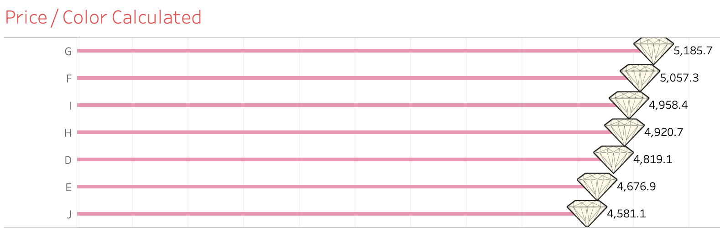
Diamonds from Color ‘G’ have the highest price per carat.
20

Slide 21
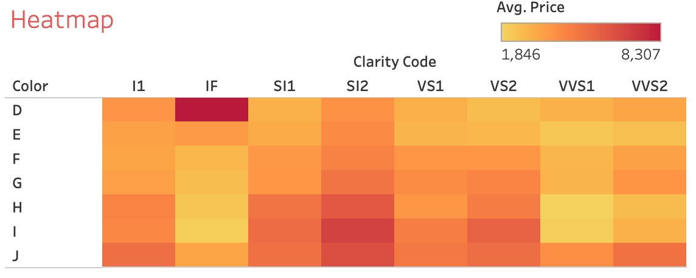
We notice that diamonds from color ‘D’ & clarity ‘IF’ have the highest average price.
21

Slide 22
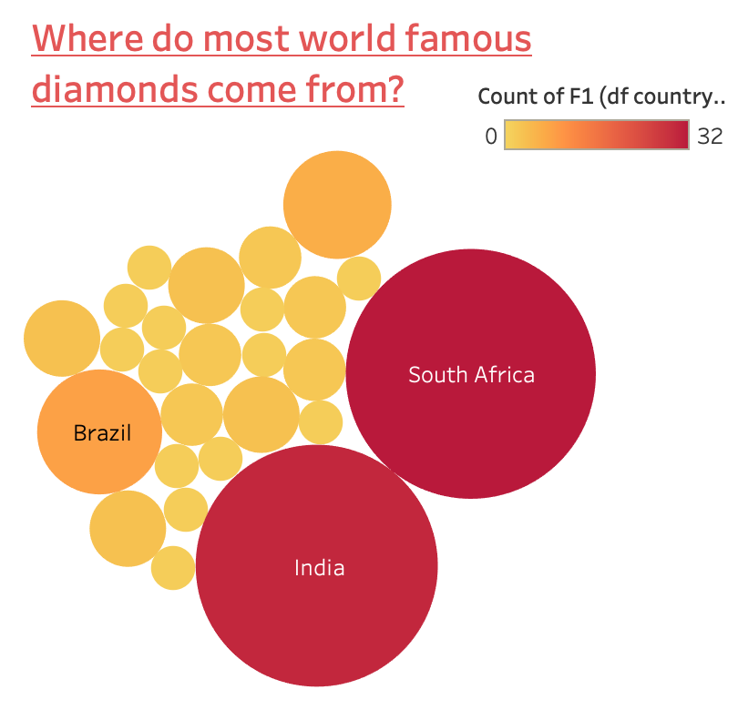
SOUTH AFRICA
32x
SOUTH AFRICA
30x
INDIA
8x
BRAZIL
22

Slide 23
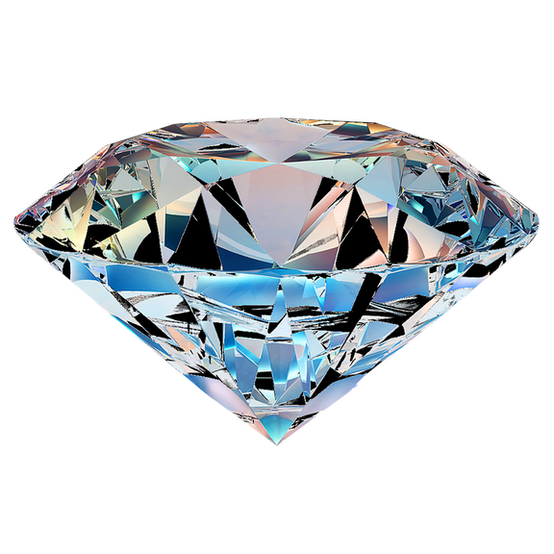
MODEL LEARNING
Steps involved in Model Building
Setting up features & target
Build a pipeline of standard scalar & model for five different regressors.
Fit all the models on training data
Get mean of cross-validation on the training set for all the models for negative root mean square error
Pick the model with the best cross-validation score
Fit the best model on the training set
23

Slide 24
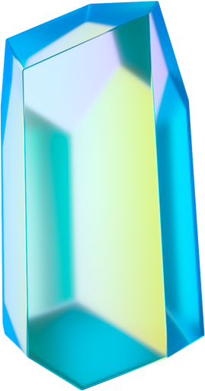
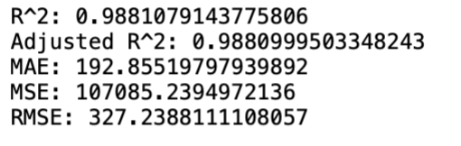
MODELS TESTED
Linear Regression
Decision Tree Regressor
Random Forest Regressor
KNeighbors Regressor
XGB Regressor - Winning Model
24

Slide 25
CONSLUSIONS & RESULTS
01
We noticed a significant relationship between Color & Cut, and between Color & Clarity.
02
We can infer that the G grade has mostly ideal & premium cuts (14.4%) and that the majority of “Very Good” and “Good” diamonds (13.1%) are of E grade.
03
The most expensive diamonds were of the D and J grades.
25

Slide 26
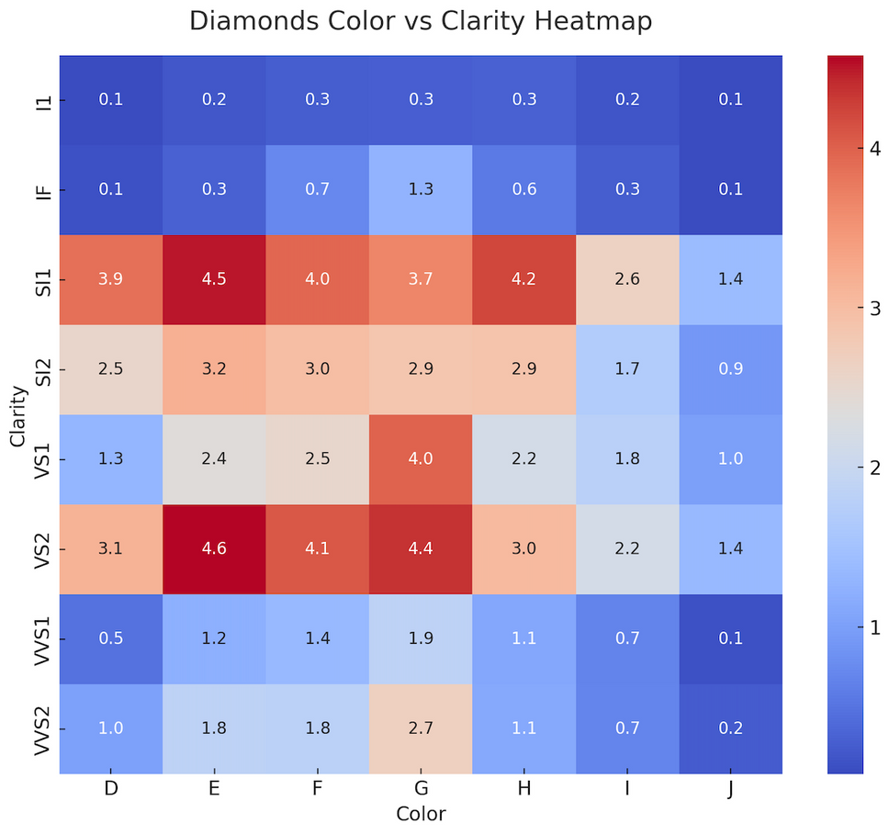
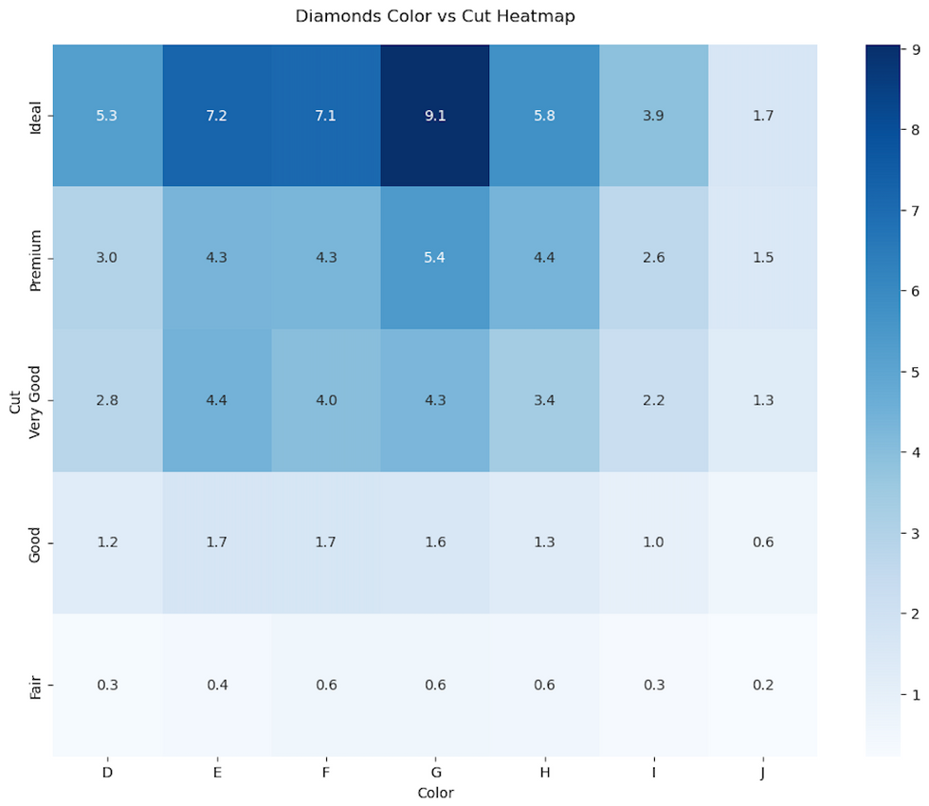
26

Slide 27
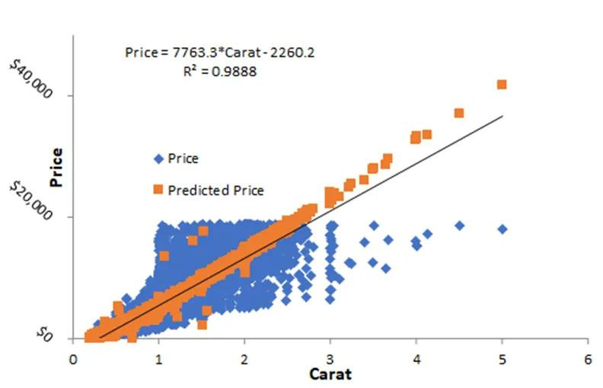
04
A solid correlation (≈ 1.0) between the diamond’s weight & volume.
05
A strong correlation (0.92) was also found between carat and price.
06
The model can predict the price of a diamond when the weight is known.
Correlation coefficient of 0.988
27

Slide 28
THE RESULTS FROM OUR QUESTIONS SUGGEST THAT IF AN INTERESTED BUYER WANTS TO SELECT A GOOD DIAMOND, IT SHOULD BE FROM COLOUR CATEGORIES E, F, AND G. THE BEST DIAMONDS DO NOT FALL IN THESE CATEGORIES BY CHANCE AND KNOWING THE WEIGHT OF A GOOD DIAMOND CAN BE USED TO ESTIMATE ITS PRICE.
28

Slide 29
Highlights
01
SQL : Has proved to me once again of how much powerful software it can be.
02
Tableau : I enjoyed working on it, and see so much growth potential.
03
Machine Learning : Test / Train. The sky is the limit, one can say.
29

Slide 30
Challenges
01
Data Gathering (Initial project idea)
02
APIs
03
Time Management
30

Slide 31
Next Steps
01
Find deeper relationships between the tables and give an overall better deeper analysis of the market.
02
Introduce the different important mines to the analysis.
03
Targeting couple of luxury jewelry brands, analyse their data bases available online. Example: Cartier, Tiffany & Co.
31

Slide 32
Fun Facts
Lucy in the Sky with Diamonds
One of the greatest hits by Beatles in 1967.
In 2004, scientists have discovered a giant dying star, whose surface has completely crystalized into diamonds.
Its size? A staggering 10 billion trillion trillion carats.
32

Slide 33
ANOTHER FUN FACT, IF YOU ARE BORN IN APRIL,
YOUR BIRTHSTONE IS THE DIAMOND💎
33

Slide 34
Thank you!
Any Questions?!
*All references & links mentionned in the report file
34

